Slide 1
VISUAL and SOUND Design in Video Games
A Presentation by Jordan Durci

Slide 2
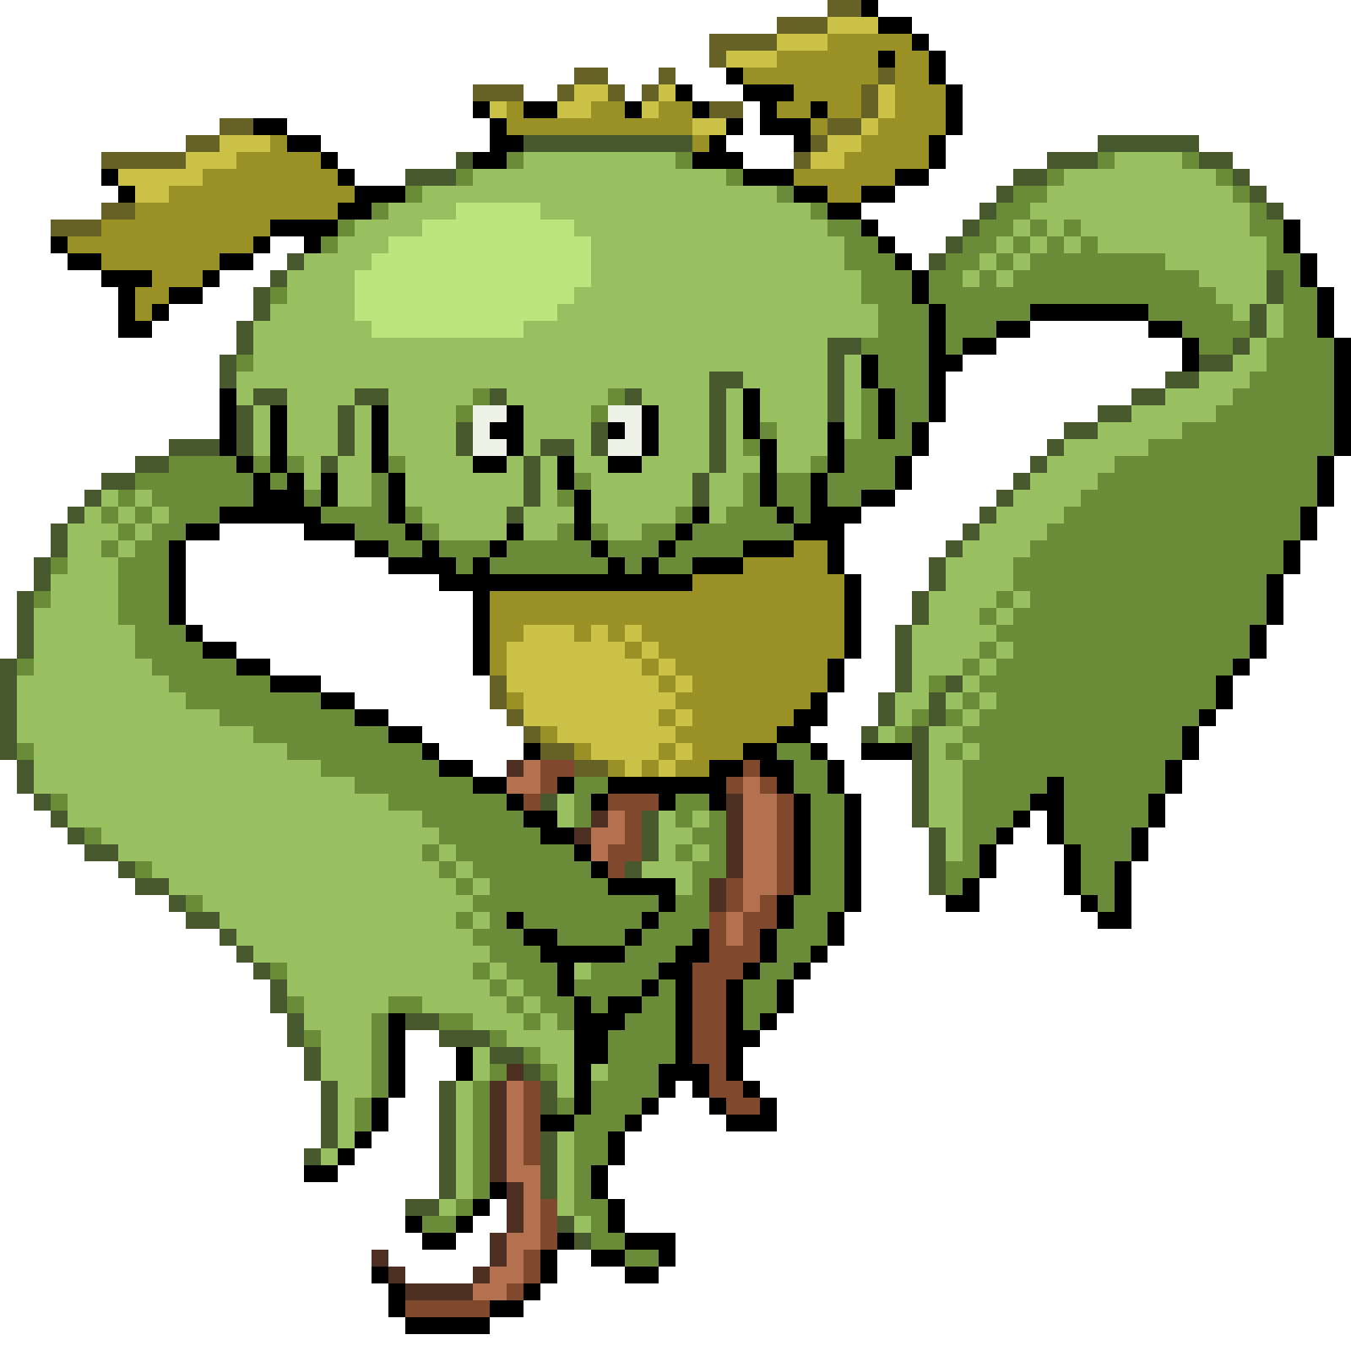
What is VISUAL design in Games?
The design of every visual element in a game
Includes:
Models
Textures
Sprites
Fonts
Etc.

Slide 3
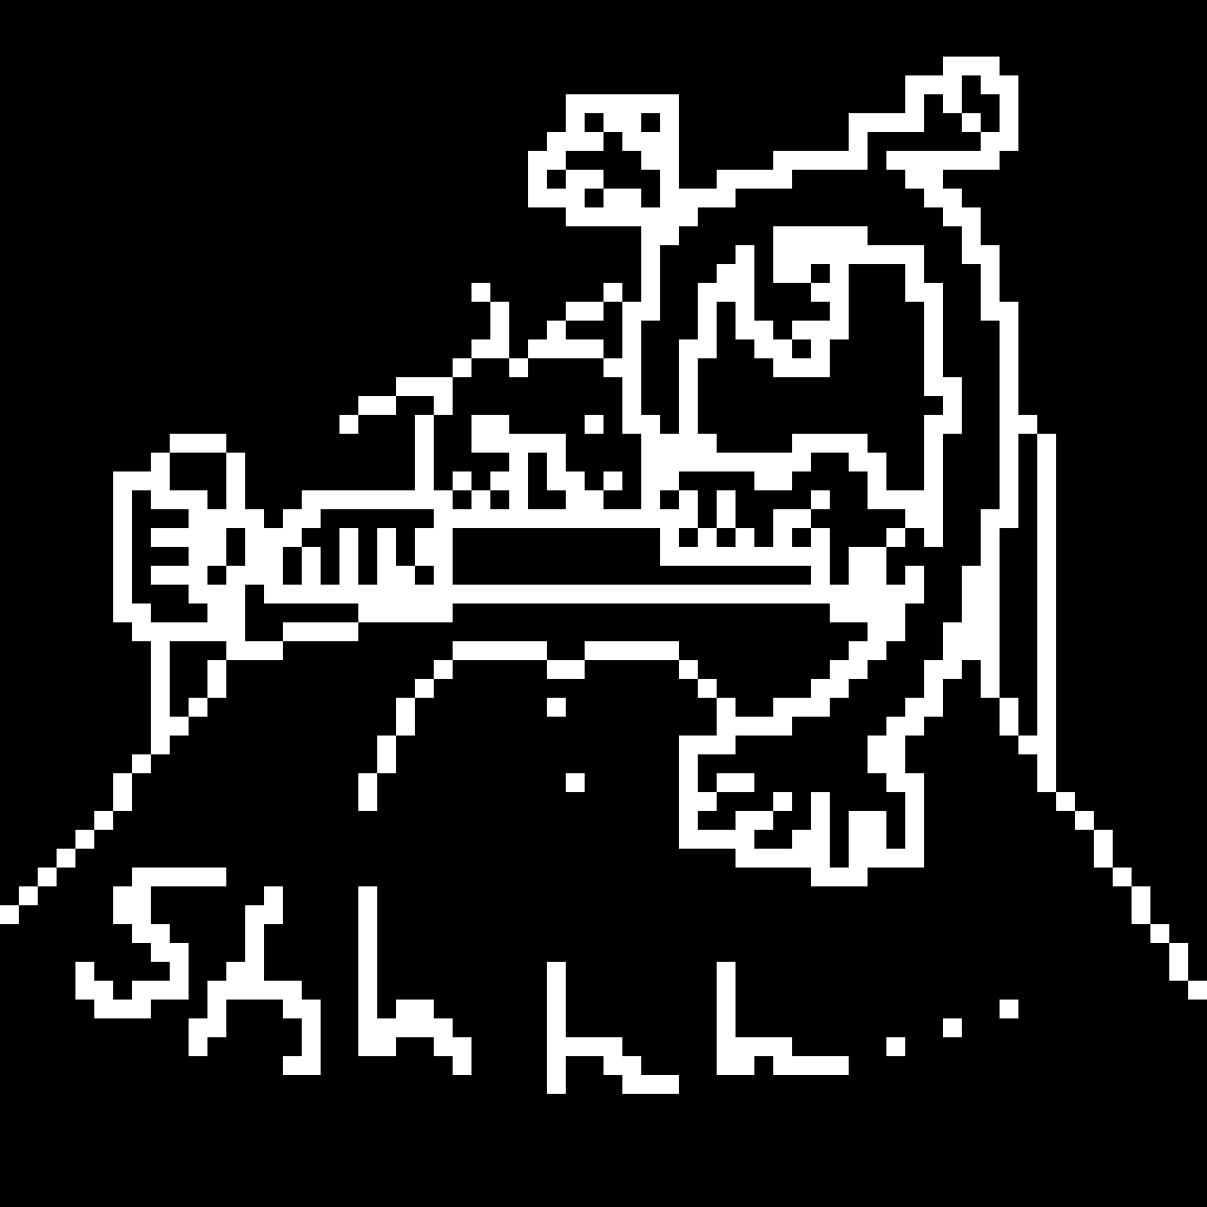
WHY is it important?
Communication
What visual design can communicate:
Themes and styles
Atmosphere and mood
Character

Slide 4
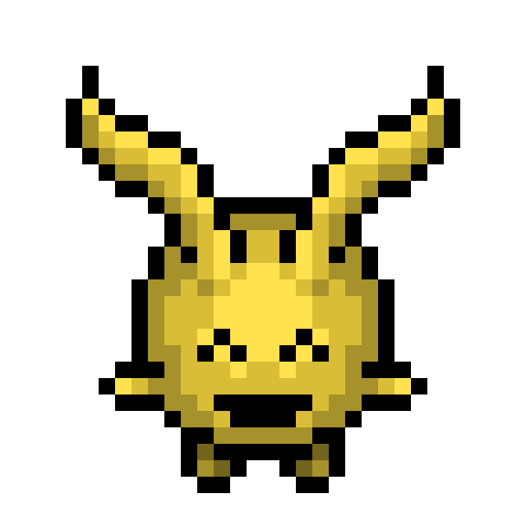
Aspects I’ll be Discussing
Style
The overall concepts behind the visual design
Tone
The mood the design seeks to convey
Animation
How motion connects with the visual elements
Fonts

Slide 5
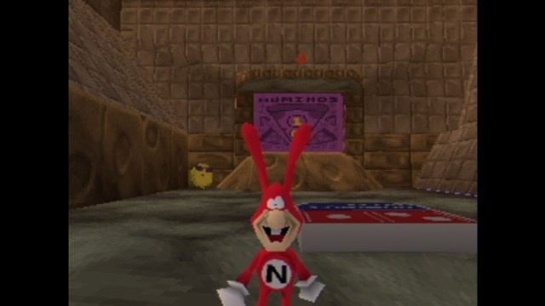
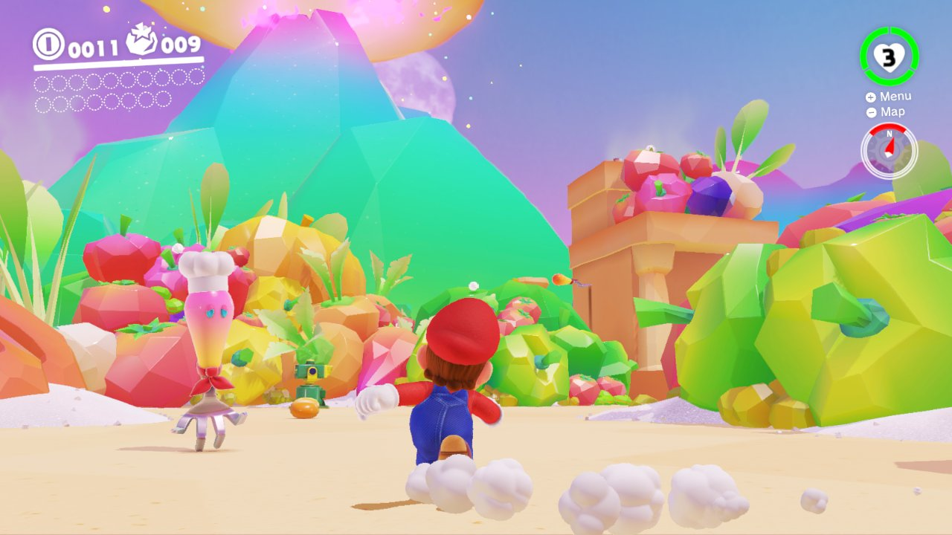
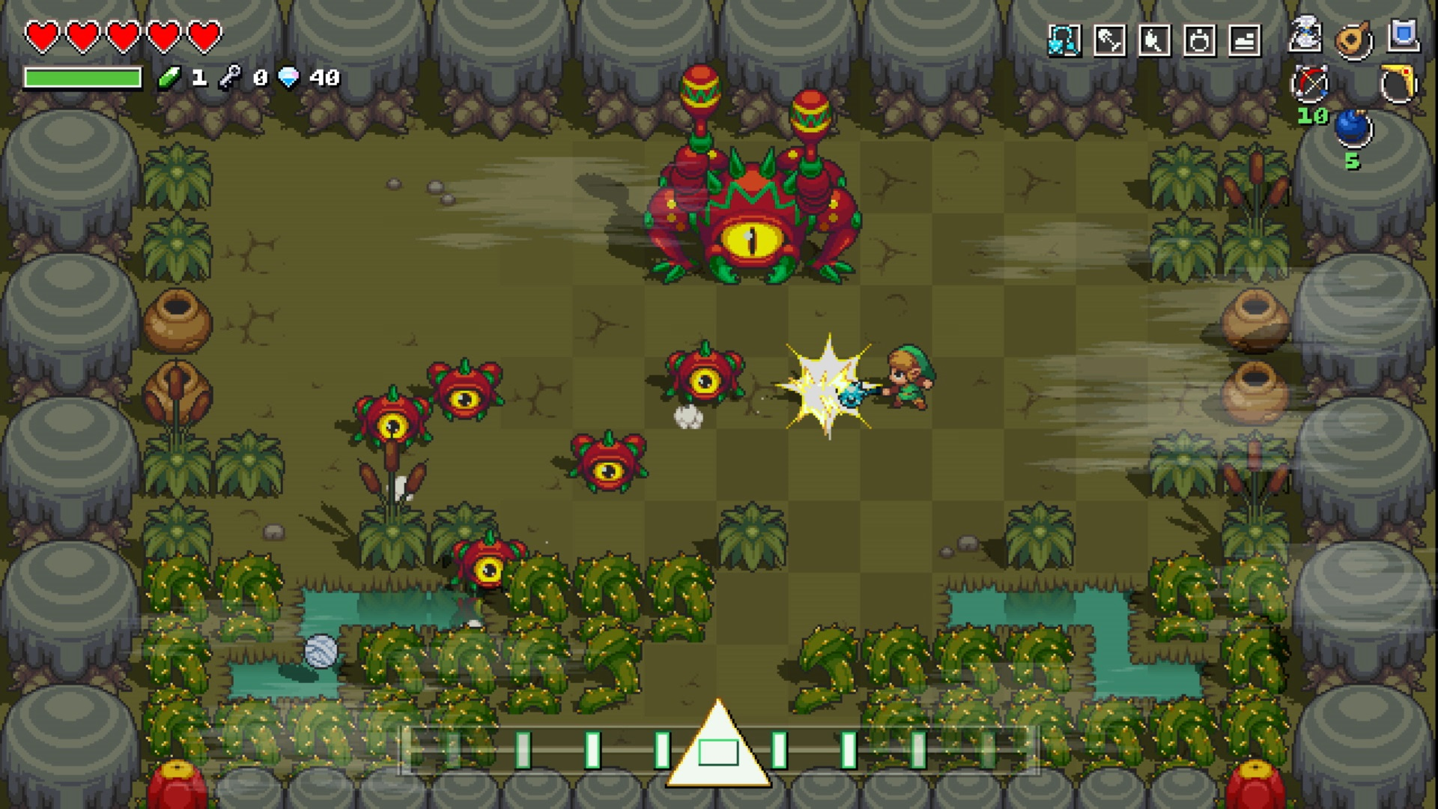
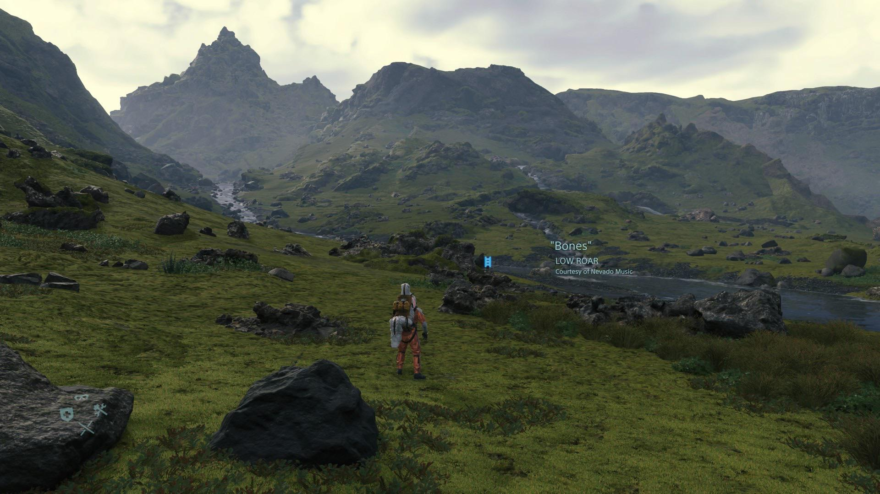
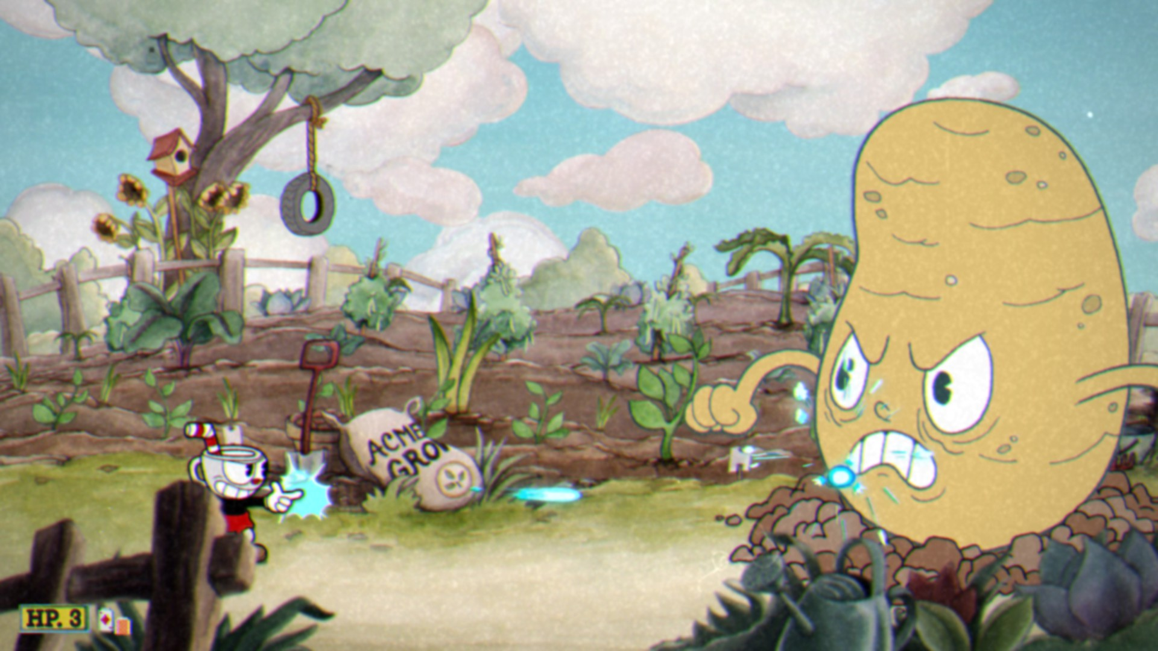
Art Styles
How a game looks
Realistic
Cartoony
Retro
Can be cohesive…
…or disjointed
Why might you disjoint styles?
Notes:
Game names:
Death Stranding
Cuphead
Cadence of Hyrule
Yo! Noid II: Enter the Void
Super Mario Odyssey

Slide 6
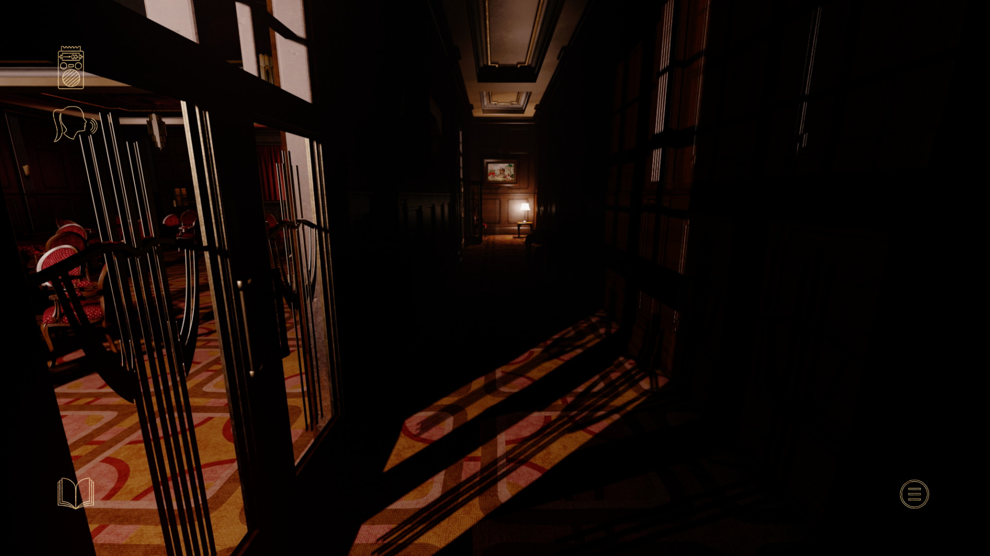
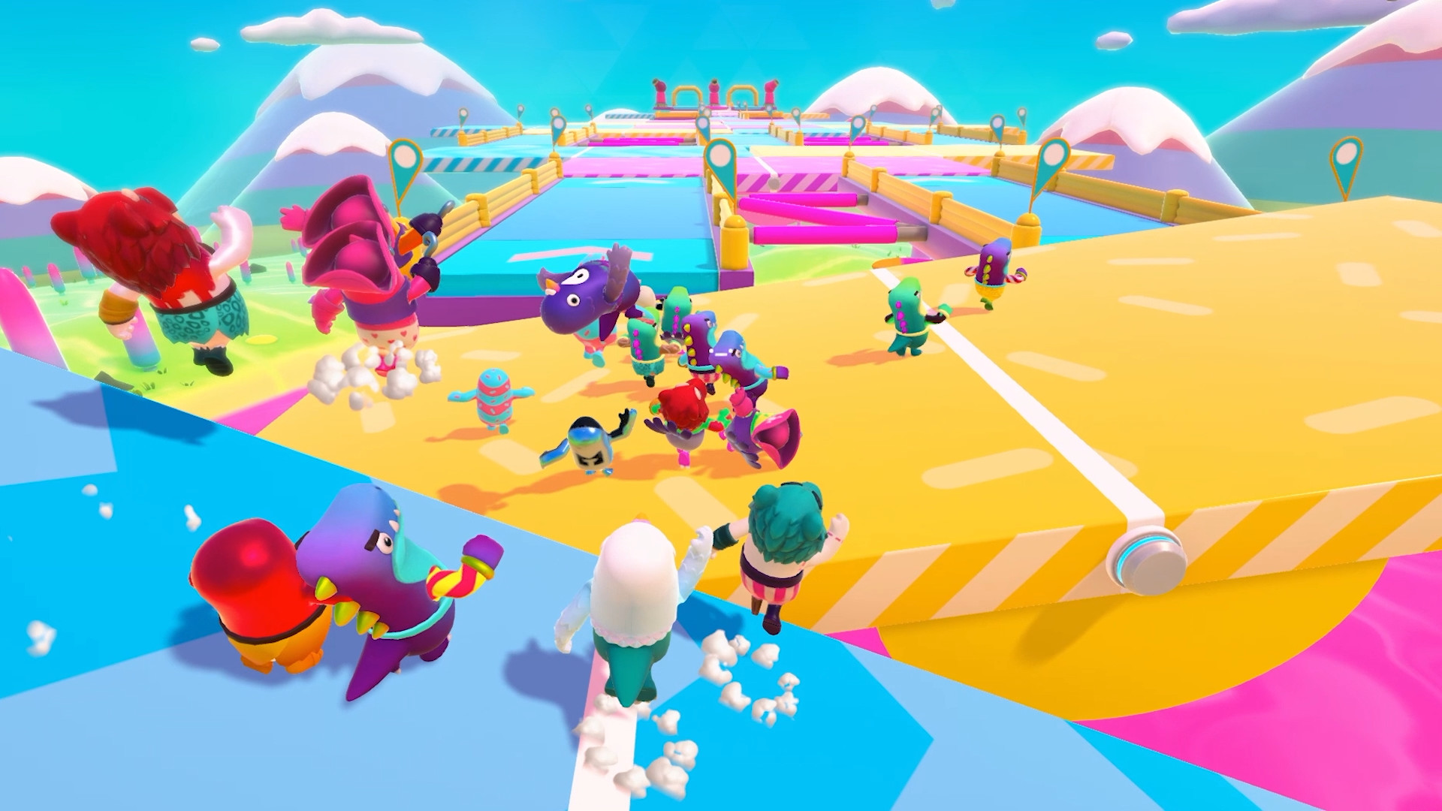
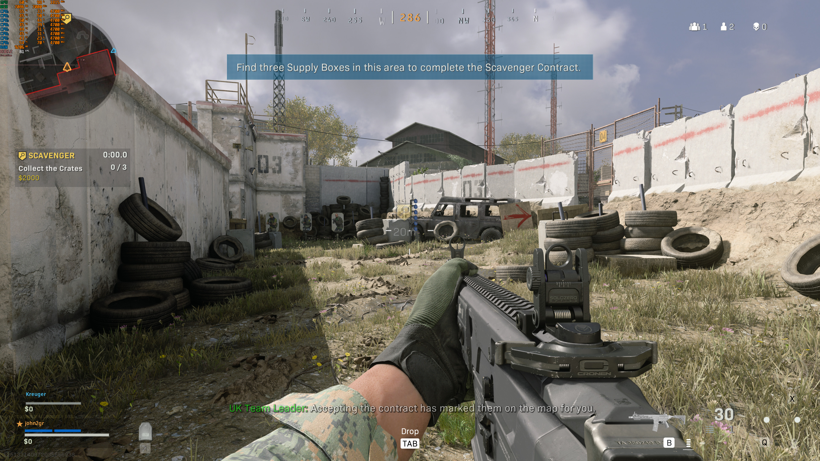
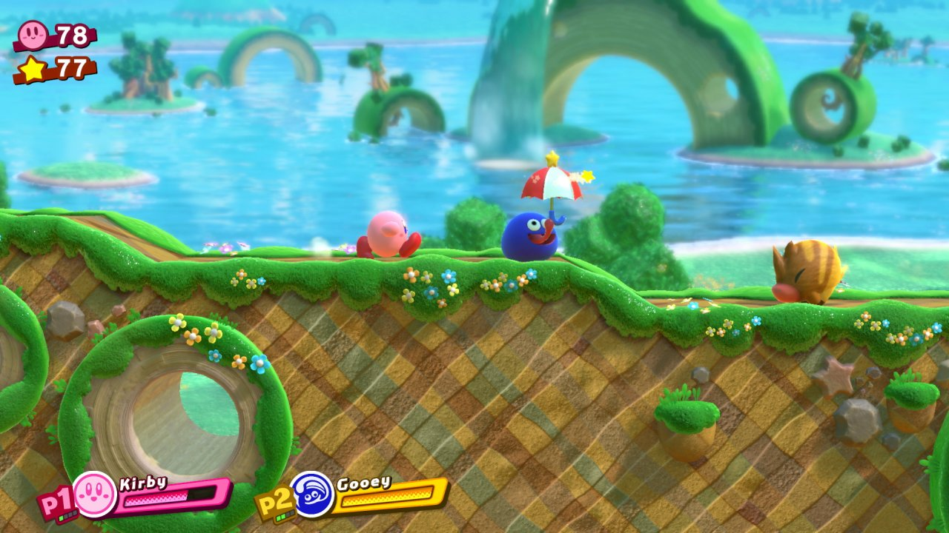
Communicating Tone Visually
Closely tied to art style
Tone comes from atmosphere
Dark and foreboding
Bright and jubilant
Harsh and gritty
Soft and pleasant
Notes:
Game names:
At Dead of Night
Fall Guys: Ultimate Knockout
Call of Duty: Warzone
Kirby Star Allies

Slide 7
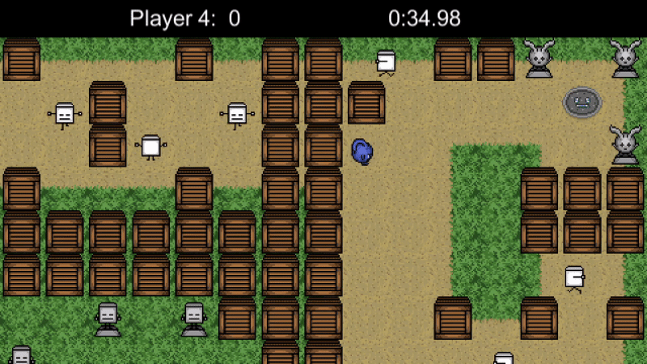
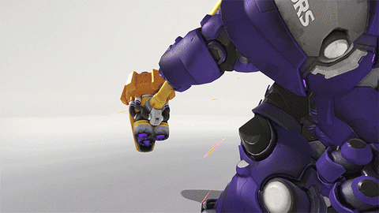
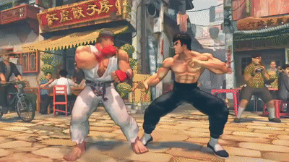
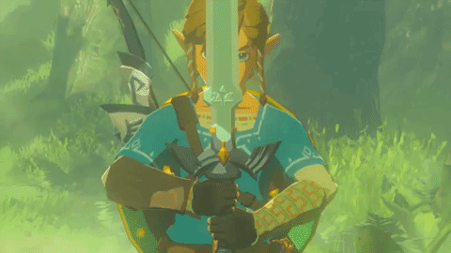
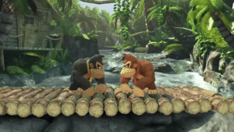
Video Game Animation
Follows many of the principles
Squash and stretch
Anticipation
Arcs
Secondary Animation
Exaggeration
Etc.
Notes:
Game names:
Emotion Commotion
Overwatch
Super Smash Bros. Ultimate
The Legend of Zelda: Breath of the Wild
Super Street Fighter IV

Slide 8
Video Game Font Choice
Games are digital media
Not all fonts are comfortable on screens
Screen-friendly fonts
Sans serif fonts
Screen-unfriendly fonts
Serif fonts
Not all fonts are clean and readable, either
All have uses, though

Slide 9
Video Game Font Choice
When to use clean sans serif fonts…
If a UI element needs to be easily read
If a menu needs to be comfortable to look at with large amounts of text
When it needs to feel retro

Slide 10
Video Game Font Choice
When to use fonts that aren’t cleaner sans serif fonts…
If something is printed on paper
If something is handwritten
If something needs to feel old
If a title card on screen needs to stand out
When it fits the style

Slide 11

What is sound design?
The design of every sound effect in a game
A vital form of communication between game and player
Can make or break aspects of the game
One of the most fun parts of game design

Slide 12
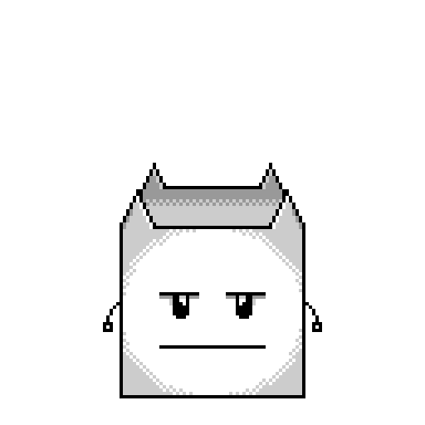
WHY is it important?
Once again, communication
What sound design can communicate:
Atmosphere
Impact or intensity
Style
Sells animations

Slide 13

Communication through sound
What the player is doing or has done
Active sound design
What’s happening in the game
Passive sound design

Slide 14

Important Aspects of Sound
Pitch
Frequency
Anatomy and length
Envelopes
Time and lengths
Dynamics

Slide 15

Use of Frequency
Scale
High frequencies indicate small scale
Low frequencies indicate large scale
Energy
Low frequencies indicate low energy
High frequencies indicate high energy
Notes:
Bananaman small sounded kinda like Toad.

Slide 16
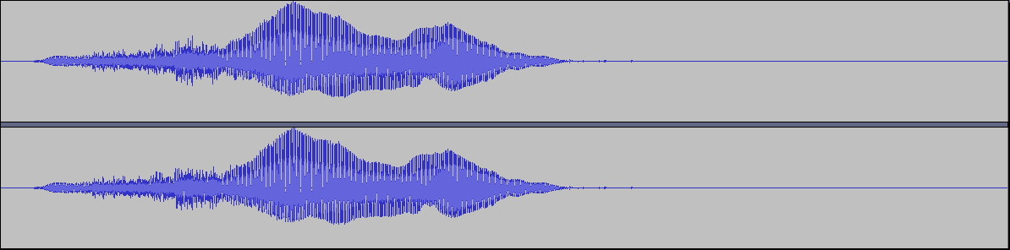
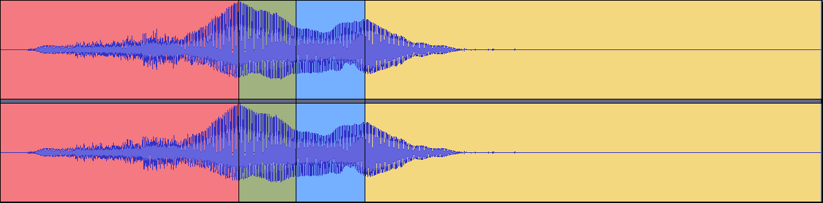
What are Envelopes?
Attack
Decay
Sustain
Release
Notes:
Sound plays at the end.

Slide 17
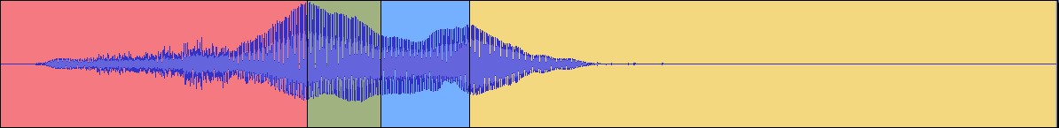
What are DYNAMICS?
Playing with envelopes to change perception of sound
Attack
Longer attacks build anticipation
Release
Longer releases can add power or character

Slide 18
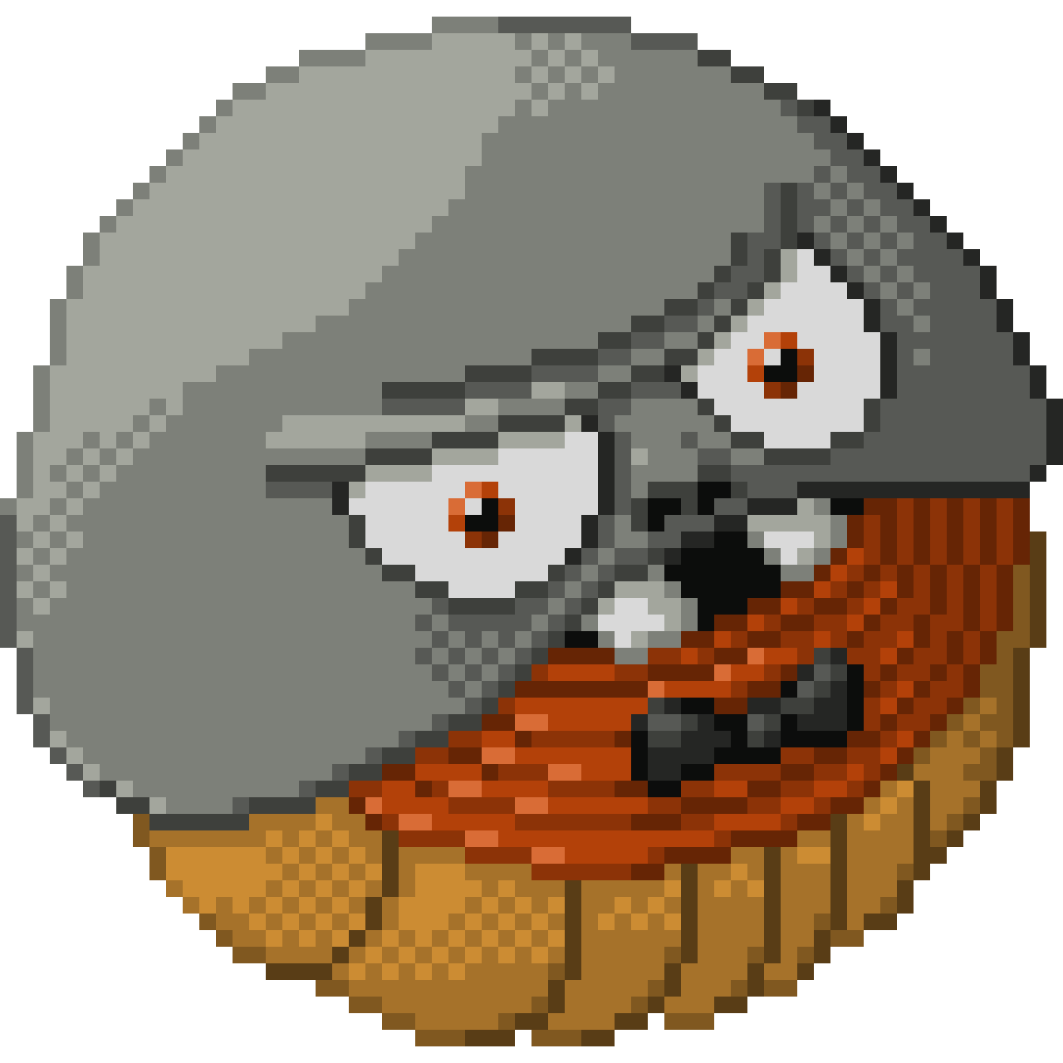
What are DYNAMICS?
What do you think would happen if you lengthened the decay of a sound effect?
What about the sustain?

Slide 19
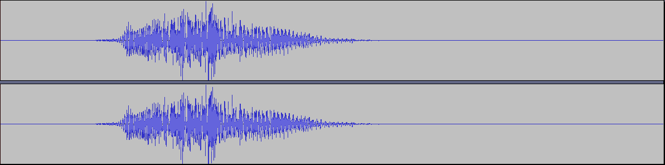
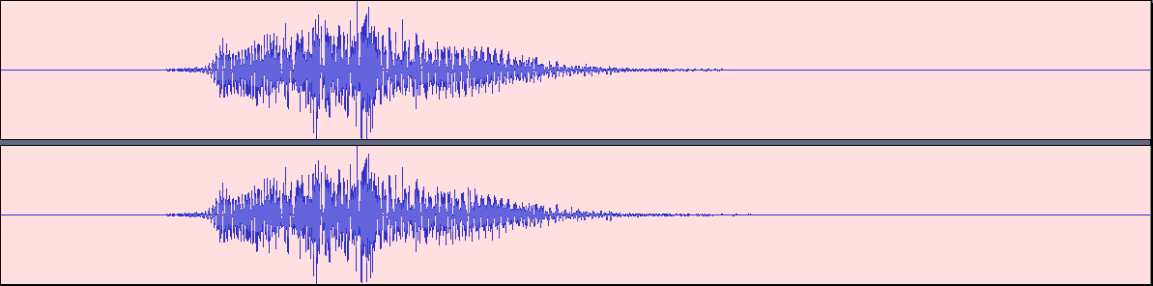
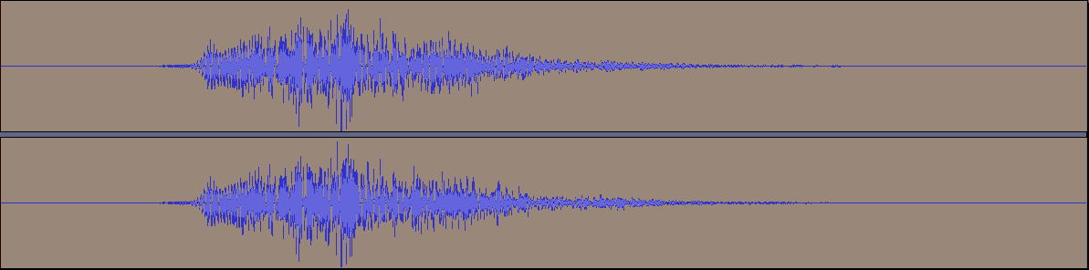
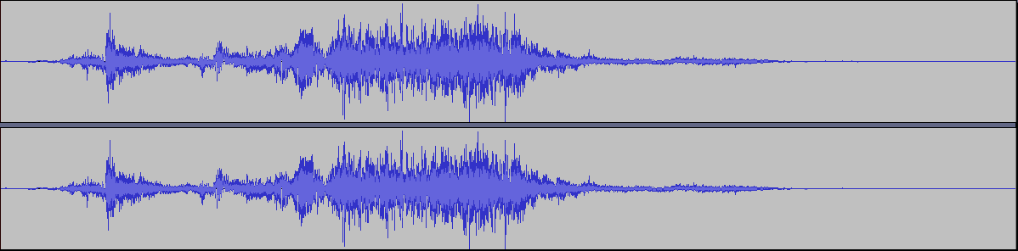
Important Sound Design Tools
Reverb
Connecting sounds
Atmosphere
Foley
Recording sounds with props
Sound Libraries
Finding pre-recorded sounds
Notes:
Sound effects play after “Reverb,” “Connecting sounds,” “Atmosphere,” and “Finding pre-recorded sounds/”

Slide 20
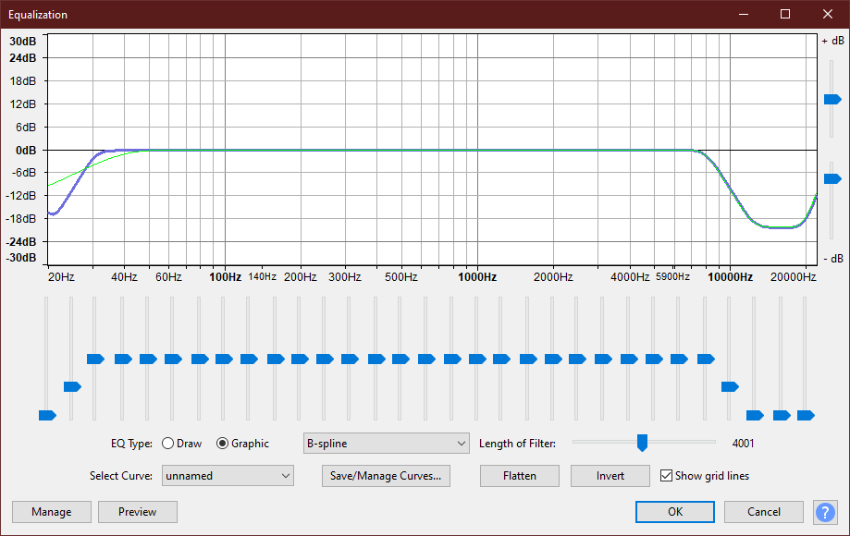
Professional Sound Design Tools
Attenuation
Using distance to change effect volumes
Can be dynamic
Equalization
Shifting the volumes of frequency ranges
Can be used to remove background noise
Can be used to shift sound pitch with less distortion

Slide 21

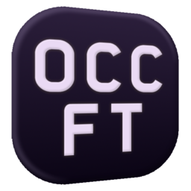
Free Software for Sound Design
Audacity
Deep, lightweight
FamiTracker
Deep, retro

Slide 22
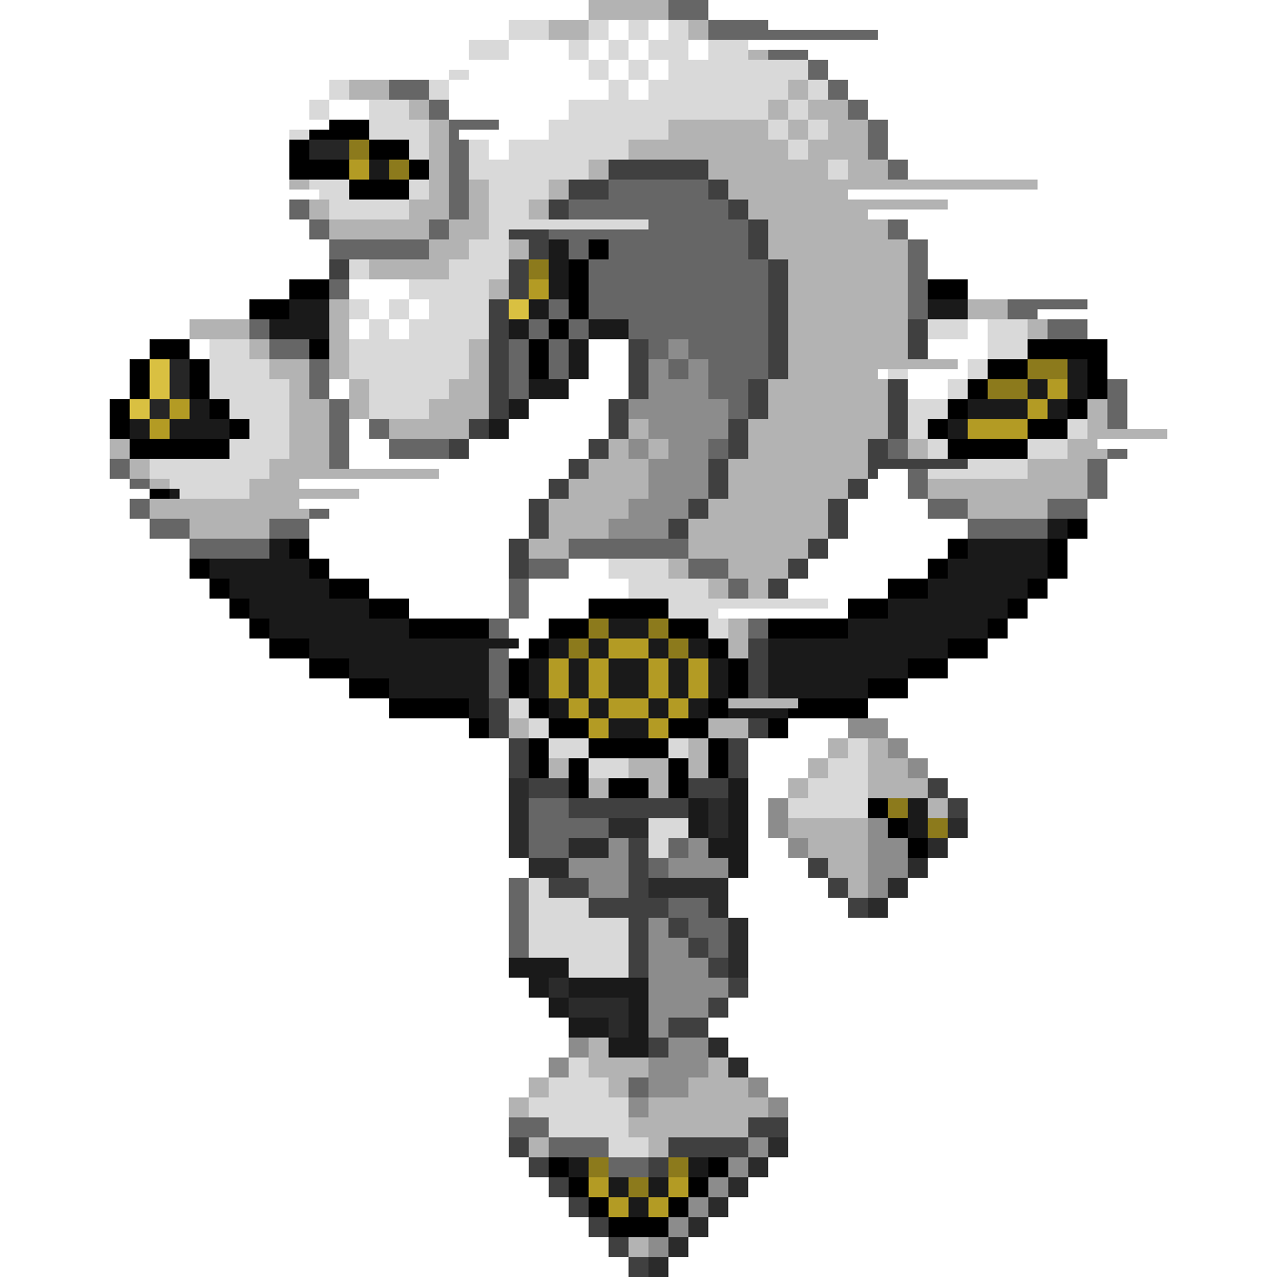
Questions?

Slide 23
CITATIONS ^{(In Order of Appearance)}
Death Stranding
Cuphead
Cadence of Hyrule
Yo! Noid 2: Enter the Void
Super Mario Odyssey
At Dead of Night
Fall Guys: Ultimate Knockout
Call of Duty: Warzone
Kirby Star Allies
Overwatch
Super Smash Bros. Ultimate
The Legend of Zelda: Breath of the Wild
Super Street Fighter IV
So You Wanna Make Games?? | Episode 8: Sound Design
Audacity
FamiTracker

